Slide 1
Tools related to Android Dev
rongbo.zou@gmail.com

Slide 2
探讨的一些点
Android Studio
Gradle-based build system
MacBook
Charles

Slide 3

Android Studio
Google官方开发
基于JetBrains IntelliJ IDEA
Android平台开发程序的IDE
集成了Gradle构建系统
Notes:
http://developer.android.com/sdk/index.html
https://zh.wikipedia.org/wiki/Android_Studio
http://tools.android.com/recent

Slide 4
刚开始一些设置
皮肤设置(Darcula)
快捷键
字体大小
……

Slide 5
一些特性
定制不同的包
内置终端
Find usages
快捷搜索功能
完善的插件系统
Git, Markdown,Gradle,反编译等插件

Slide 6
一些特性
颜色、图片在布局和代码中可以实时预览
String、dp、px等信息可以实时预览
debug时自动在源码中插入变量值
……

Slide 7
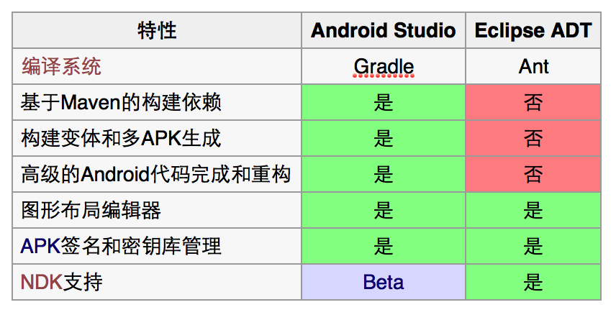
Android Studio和Eclipse ADT比较
Notes:
https://zh.wikipedia.org/wiki/Android_Studio
http://developer.android.com/tools/studio/eclipse-transition-guide.html#project-structure
project structure, build system, debugging, and application packaging

Slide 8
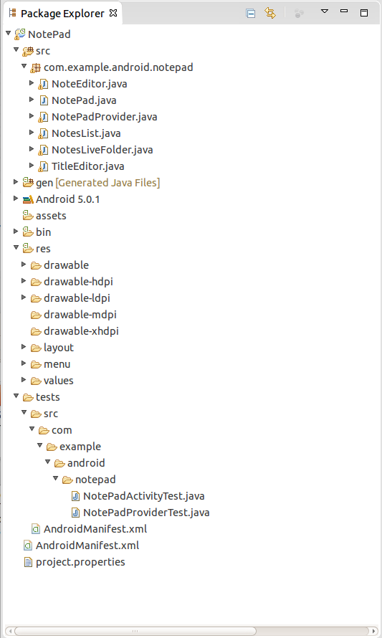
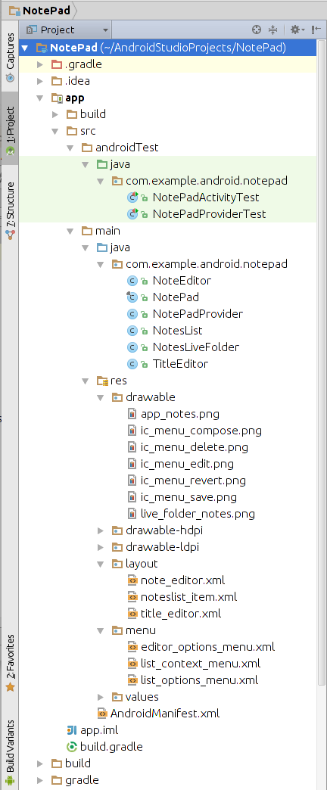
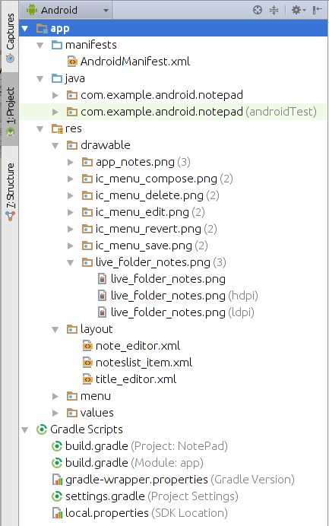
Android Studio和Eclipse ADT比较
Notes:
https://zh.wikipedia.org/wiki/Android_Studio
http://developer.android.com/tools/studio/eclipse-transition-guide.html#project-structure
project structure, build system, debugging, and application packaging

Slide 9
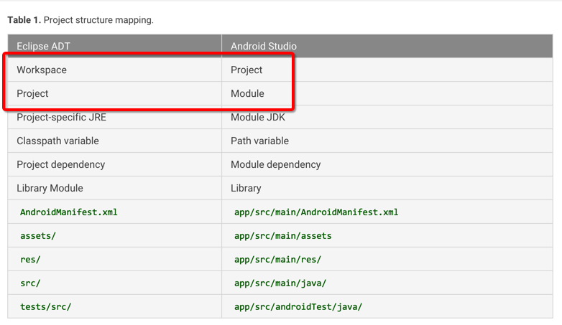
Android Studio和Eclipse ADT比较
Notes:
https://zh.wikipedia.org/wiki/Android_Studio
http://developer.android.com/tools/studio/eclipse-transition-guide.html#project-structure
project structure, build system, debugging, and application packaging

Slide 10
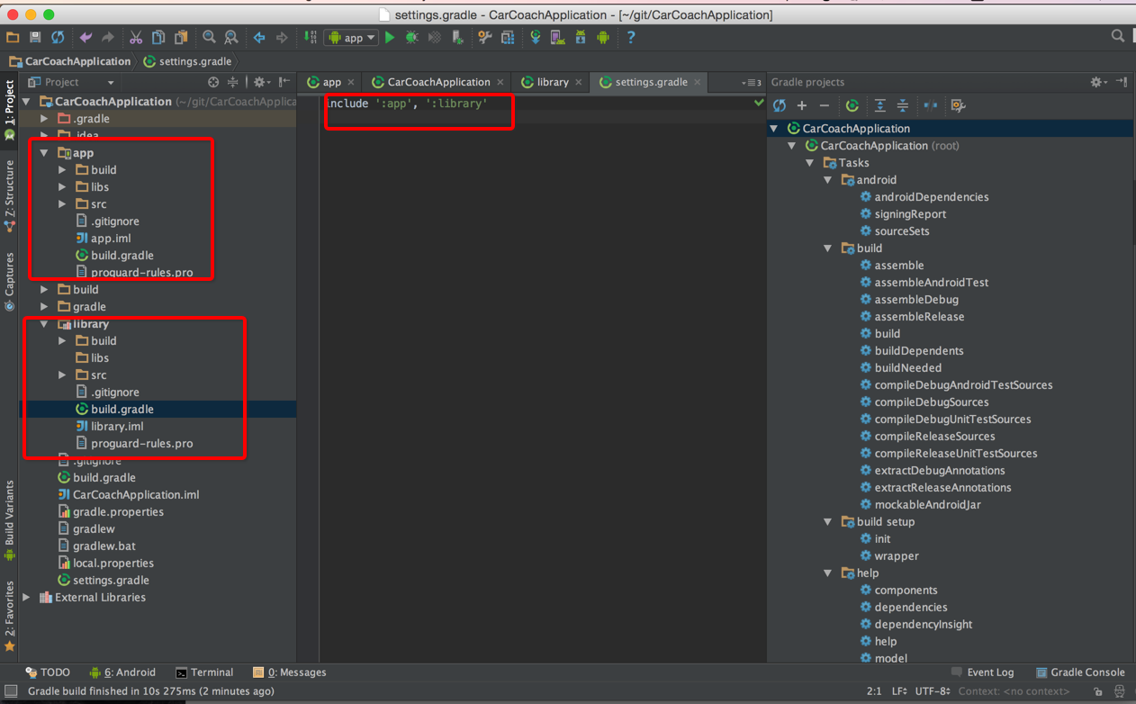
An Android Studio Project

Slide 11
An Android Studio Project(Module)
A module is a component of your app that you can build, test, or debug independently.
Android application modules APK packages
Android library modules AAR (Android ARchive)
App Engine modules contain code and resources for App Engine integration.
Java library modules jar
Notes:
http://developer.android.com/tools/building/plugin-for-gradle.html

Slide 12

Gradle
Gradle is an advanced build toolkit that manages dependencies and allows you to define custom build logic.
Gradle build files use Domain Specific Language (DSL) to describe and manipulate the build logic through Groovy syntax.
Notes:
http://gradle.org/
https://zh.wikipedia.org/wiki/Gradle

Slide 13
Build files for Studio Proj
Project build file
Gradle repositories(JCenter, Maven Central, or Ivy) and dependencies
Module build file
configure module build settings, including overriding the src/mainmanifest settings and setting custom packaging options.
Notes:
http://developer.android.com/tools/building/plugin-for-gradle.html

Slide 14
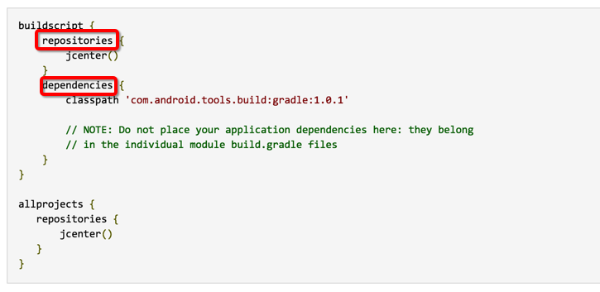
Project build file

Slide 15
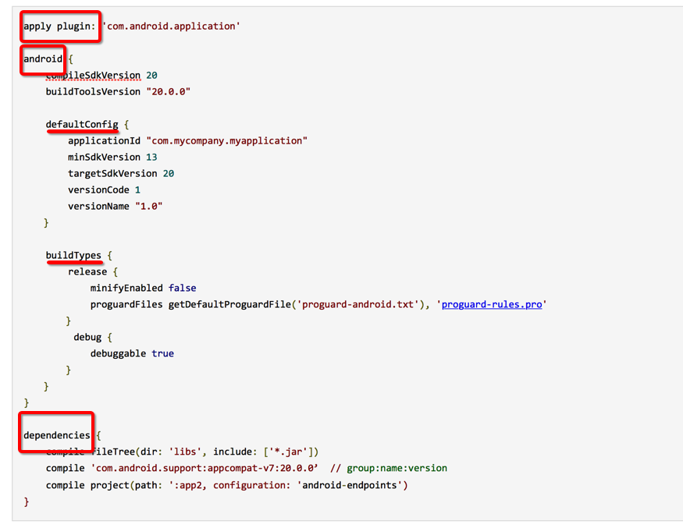
Module build file

Slide 16
Configuring Gradle Builds
Build variants
buildTypes
productFlavors
Dependencies
Manifest entries
Signing
ProGuard
Testing
Notes:
http://developer.android.com/tools/building/configuring-gradle.html
http://developer.android.com/tools/building/plugin-for-gradle.html

Slide 17
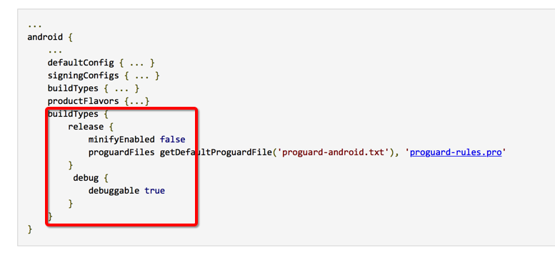
Build variants(buildTypes)
Notes:
http://developer.android.com/tools/building/configuring-gradle.html
http://developer.android.com/tools/building/plugin-for-gradle.html

Slide 18
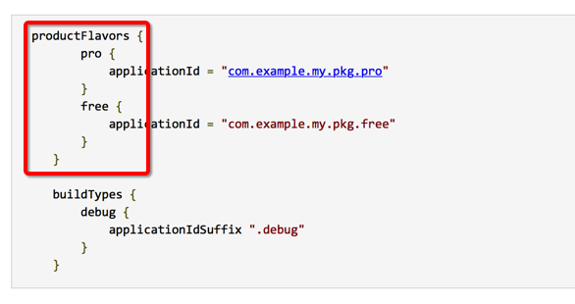
Build variants(productFlavors)
Notes:
http://developer.android.com/tools/building/configuring-gradle.html
http://developer.android.com/tools/building/plugin-for-gradle.html

Slide 19
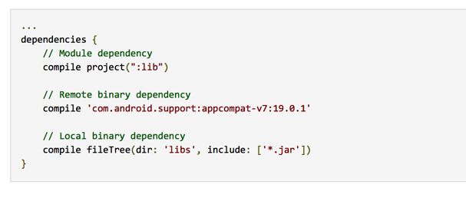
Dependencies
Notes:
http://developer.android.com/tools/building/configuring-gradle.html
http://developer.android.com/tools/building/plugin-for-gradle.html

Slide 20
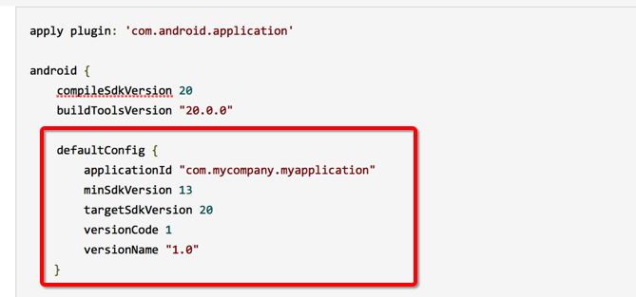
Manifest entries
Notes:
http://developer.android.com/tools/building/configuring-gradle.html
http://developer.android.com/tools/building/plugin-for-gradle.html

Slide 21
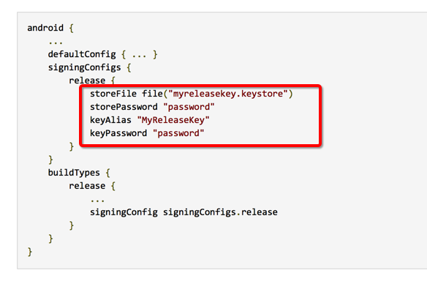
Signing
Notes:
http://developer.android.com/tools/building/configuring-gradle.html
http://developer.android.com/tools/building/plugin-for-gradle.html

Slide 22
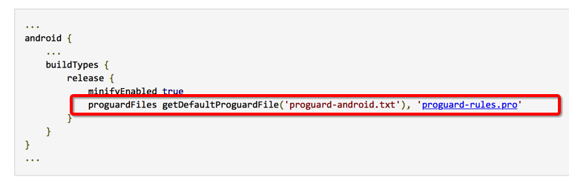
ProGuard
Notes:
http://developer.android.com/tools/building/configuring-gradle.html
http://developer.android.com/tools/building/plugin-for-gradle.html

Slide 23
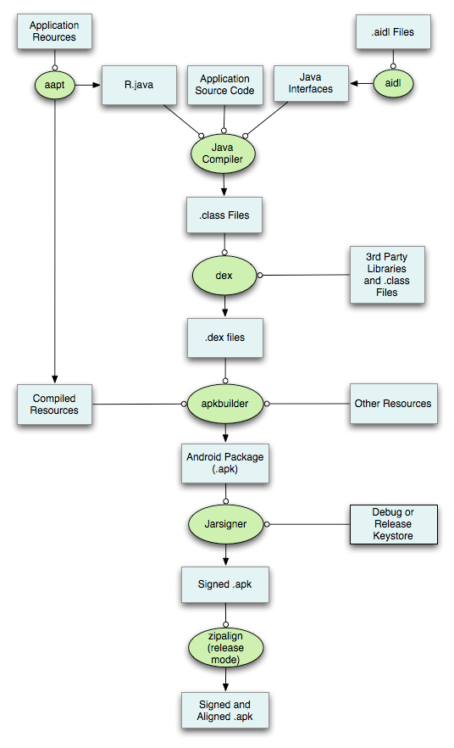
A Detailed Look at the Build Process
Notes:
http://developer.android.com/images/build.png
http://developer.android.com/sdk/installing/studio-build.html#detailed-build

Slide 24
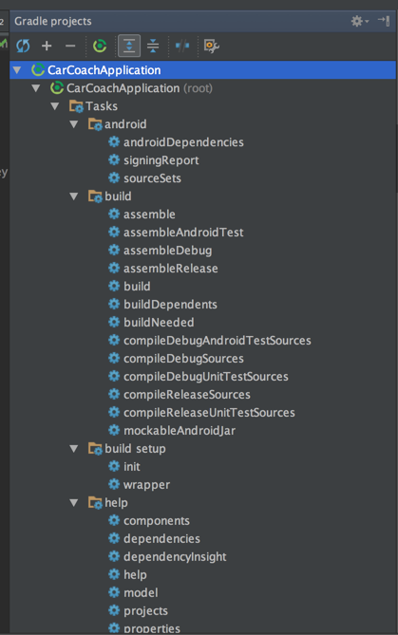
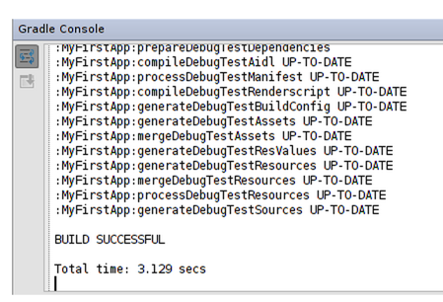
Build Tasks
Notes:
./gradlew tasks

Slide 25
Migrating to Android Studio
Migration Prerequisites
使用最新版本的Android Studio
能够翻墙
Migration options:
Android Studio Importer
依赖管理更方便
标准工程结构，支持flavor and build type specific resources等等
Eclipse Exporter
同时支持AS，Eclipse
Notes:
http://developer.android.com/sdk/installing/migrate.html
http://tools.android.com/tech-docs/new-build-system/migrating-from-eclipse-projects
http://developer.android.com/tools/studio/eclipse-transition-guide.html#project-structure
sourceSets{xxx}

Slide 26

MacBook
MacTalk·池建强
http://macshuo.com/
Notes:
http://macshuo.com/

Slide 27

Charles
一款类似Fiddler的HTTP Web Debug Tool
Notes:
http://www.charlesproxy.com/

Slide 28
其他
Resources merging & Manifest merging
优先级由低到高
dependencies --> src/main/ --> src/productFlavor/ --> src/buildType
Notes:
http://developer.android.com/tools/building/manifest-merge.html

Slide 29
其他
Gradle wrapper files
A JAR file
A properties file
A shell script for Windows platforms
A shell script for Mac and Linux platforms
http://stackoverflow.com/questions/25769536/how-when-to-generate-gradle-wrapper-files

Slide 30
其他
关于加快android studio的build速度
http://stackoverflow.com/questions/16775197/building-and-running-app-via-gradle-and-android-studio-is-slower-than-via-eclips
http://stackoverflow.com/questions/17324849/android-studio-gradle-build-speed-up

Slide 31
参考资料
http://developer.android.com/sdk/index.html
http://gradle.org/
http://tools.android.com/tech-docs/new-build-system
http://www.zhihu.com/question/21534929

Slide 32
Thanks

